Slide 1
Farmington / Farmington Hills Broadband Feasibility Study
CCG Consulting & Finley Engineering
January 25, 2021

Slide 2
Operating Models We Considered
Retail Model. The cities together or a private ISP as the owner and operator of the business.
Open Access. The cities build a fiber network and lease connections to multiple ISPs which sell services.
Public / Private Partnership. The cities and an ISP build the network together, with the ISP operating the business.

Slide 3
The Residential Survey
85% of respondents have landline broadband. 50% of homes subscribe to Charter, 33% subscribe to AT&T, and 2% subscribe to WOW!. Additionally, 5.5% use cellphones for data and 2% use satellite broadband. 9.5% of homes have no broadband.
86% of respondents still subscribe to traditional cable TV service – the highest rate we’ve seen in years. This seems partially because both the telco and cable companies offer cable.
78% of homes are buying a bundle of services – another reason for the high cable penetration.
39% of homes have somebody that works at home at least parttime. 7% of homes have somebody working from home fulltime. The survey was done just as the pandemic started, so this is likely to be higher today.

Slide 4
The Residential Survey
We got the following results from a statistically valid telephone survey. A secondary online survey produced similar results.
42% of homes are dissatisfied with home broadband speeds. Reasons given include outages, inconsistent performance, and problems doing routine things like streaming video.
48% said they would move to a new network for the same prices they pay today. 78% said they would move for lower prices. Only 24% said better customer service would get them to change. 6% would change to avoid data caps.
46% of respondents would prefer for the cities to own and operate a fiber network. 27% were in favor of open access. Only 6% wanted a commercial ISP to serve with a new network.

Slide 5
Speed Tests
Charter Download Speeds
10% had download speeds under 10 Mbps
42% had download speeds under 50 Mbps
Charter Upload Speeds
33% had upload speeds under 10 Mbps
87% had upload speeds under 20 Mbps
We interpret the results to show that there are local problems in parts of the Charter network.
Note that Charter withdrew a petition at the FCC to use data caps.

Slide 6
Speed Tests
Note that AT&T stopped selling new DSL customers in October 2020.
AT&T Download Speeds
44% had download speeds under 20 Mbps
81% had download speeds under 30 Mbps
AT&T Upload Speeds
74% had upload speeds under 10 Mbps
100% had upload speeds under 20 Mbps
These are respectable speeds for a DSL network.

Slide 7
Demand for Broadband Exploding
From OpenVault
Average Household Broadband Usage growing rapidly:
1st Quarter 2018 215 gigabytes per month
1st Quarter 2019 274 gigabytes per month
1st Quarter 2020 403 gigabytes per month
To put into perspective – average high-definition movie uses 3 GB per hour, 4K movies use 7 GB.
At the end of 3rd quarter 2020, 8.8% of homes are using more than 1 terabyte of data per month (up from 4% at end of 2018).
At the end of 3rd quarter 2020, 5.6% of homes are buying gigabyte broadband (up from 1.8% at end of 2018)

Slide 8
Relative Broadband Speeds

Slide 9
Business Interviews and Surveys
Businesses were not happy with the capabilities of employees to work from home during the pandemic.
Many businesses still use AT&T, which they report was more consistent than Bright House Networks (the cable company before Charter).
Businesses told us they valued consistency more than price.
Interestingly, no business described broadband as great, just adequate. Almost every business had functions they would tackle if they had faster broadband.

Slide 10
Network Design: Key Considerations
Design Considerations
Largest Investment
Longest Estimated Life
Look Forward – Not What is
Optical Distribution Network (ODN)
80% of total Capital Expenditures
40 Year Lifespan
The most disruptive portion of the project

Slide 11
Network Design
Distribution Pedestal
Distribution Pedestal
CO
Local Convergence Cabinet
COT
OLT
Distribution Pedestal
Distribution Pedestal

Slide 12
Network Design: Key Considerations
Key Design Points
Where: Fiber Network follows existing utilities for aerial / buried construction.
Active vs Passive: Cost Model used an ODN capable of supporting both
Capacity: 10Gbps today across the entire network, the upper limits are a limitation of electronics, not the ODN
Two Data Centers: Redundant interconnect routes to provide redundancy between electronics sites
Extra fiber provided for future growth / expansion.

Slide 13
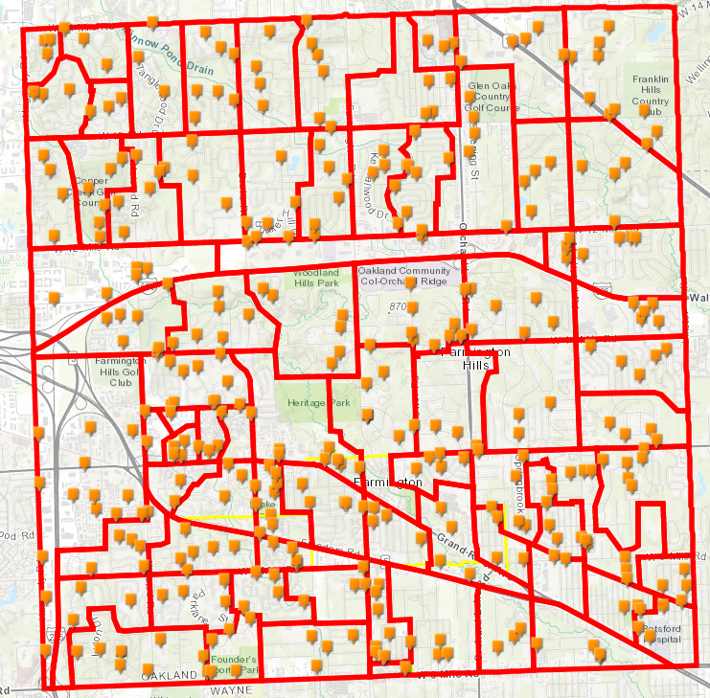
Network Design
Legend:
Farmington and Farmington Hills Boundaries
GPON Serving Areas
Route Survey Points: Locations in the field where actual buried/underground construction conditions were observed to help create the statistical model for the study. The survey looked at the following conditions:
back lot line/front lot line
aerial/buried
general space availability on existing poles
to determine how a FTTH network could be built.

Slide 14
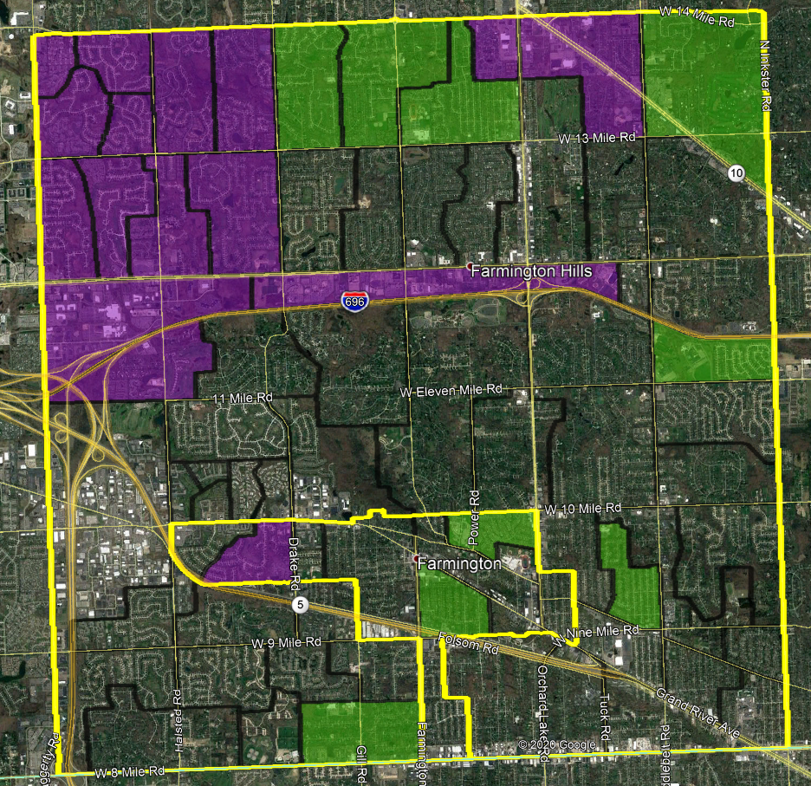
Network Design
Legend:
Farmington and Farmington Hills Boundaries
GPON Serving Areas
GPON Serving Areas where a theoretical design was completed. The design evaluated routes, construction type, and subscriber locations. The design provided theoretical fiber sizing with estimated cable footages, splicing, and drop placement information.
GPON Serving Areas where both aerial and buried routes were laid out

Slide 15
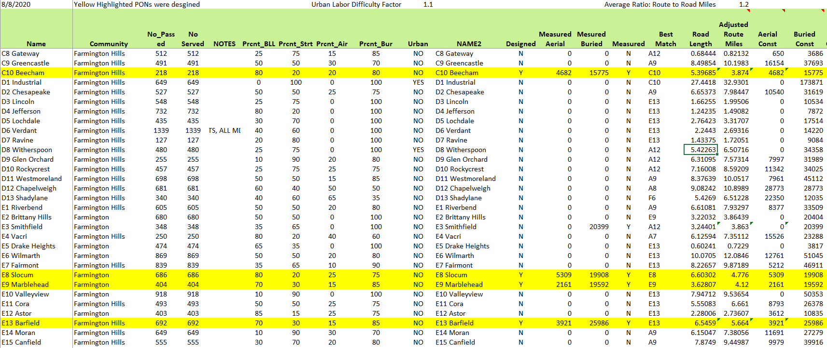
Network Design: Methodology

Slide 16
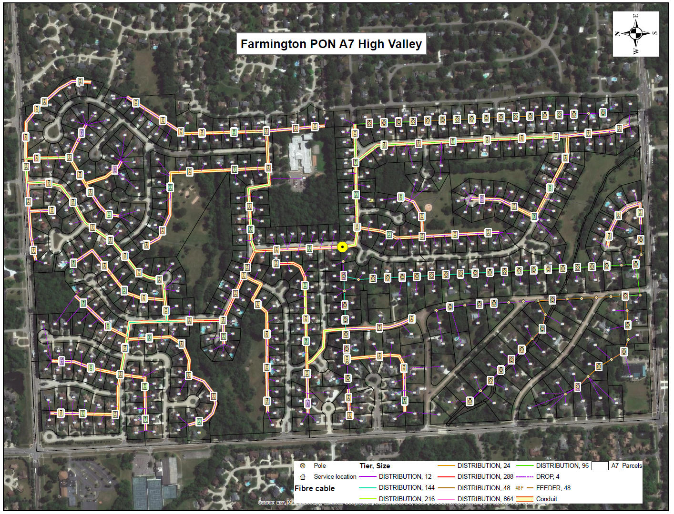
Network Design: Results

Slide 17
Miles of Fiber Construction
Farmington
Mile of Fiber Farmington Hills Both
Aerial 6.5 113.1 119.6
Buried 41.2 375.2 416.4
Total 47.7 488.2 536.0

Slide 18
Network Costs
50% Penetration Farmington
Farmington Hills Both
Fiber $ 7,793,783 $70,864,684 $ 78,658,617
Drops $ 1,626,676 $ 9.344,861 $ 11,011,477
Electronics $ 3,073,523 $13,053,456 $ 15,813,173
Huts $ 116,360 $ 188,060 $ 304,420
Operational Assets $ 528,444 $ 1,688,389 $ 1,773,604
Total $13,138,786 $95,139,450 $107,561,142
Cost per Passing $3,007 $2,144 $2,848
Cost per Customer (65%) $6,014 $4,289 $5,696

Slide 19
Products Offered
Retail
Fast Internet
Telephone
Managed WiFi
Eventually other products

Slide 20
Major Business Plan Assumptions
We looked at each city individual, plus both cities together.
Studies used Finley estimated network costs, which are conservatively high.
Base Studies considered a 50% customer penetration rate.
3-Tier broadband prices at $60 / $70 / $80
Studied impact of changing major variables like prices, penetration rates, interest rates, network costs, levels of grants
Business covering both cities adds 24 new employees over time.
Studies included periodic retirement of electronics.

Slide 21
Financing Assumptions
Considered 3 Scenarios:
100% funded with general obligation bonds
Each new customer contributes $3,500 which can be spread over as much as 10 years.
Business is formed as a cooperative and customers pay $500 to join.

Slide 22
Financial Results
$3,500
GO Bond Buy-in Coop
Asset Costs $107.6 M $104.4 M $107.6 M
Equity $ 0.0 M $ 49.5 M $ 7.1 M
Debt $121.4 M $ 70.0 M $116.0 M
Total Financing $121.4 M $119.5 M $123.1 M
Penetration Rate 50% 40% 50%
Cash after 10 Years $ 5.78 M $ 0.43 M $ 0.51 M
Cash after 20 Years $22.38 M $ 4.13 M $ 6.53 M
Rate Reduction $26 $8

Slide 23
Other Scenarios
Considered Open Access. Could not find a scenario where the cities would break even (and losses were large).
Considered a scenario of building and leasing the network to a partner. While it could work, the margins were slim for the operating partner.
Considered cities building and hiring an operator. This could work with the right partner.
Considered open access where customers pay $3,500 fee to join. This only lowers rates by $5, which didn’t feel like a good bargain related to the $3,500 buy-in.

Slide 24
Financial Conclusions
Doesn’t look feasible building ISP business in Farmington only. Too small and no economy of scale.
There are scenarios where the two cities together could create an ISP. The financial breakeven would require around a 46% penetration rate with GO Bond financing.
Open access not feasible.
Scenarios of having customers buy-in look feasible. If buy-in financed over time, then rates can drop enough to make this a breakeven for customers. The big hurdle is apartments.

Slide 25
Sensitivity Analysis
There are a few key variables that affect all scenarios:
1% Change in Penetration rate - $3.2 M in cash over 20 years
$1 Change in broadband price - $3.1 M in cash over 20 years
Interest rate change 50 basis points - $9.5 M over 20 years

Slide 26
Other Findings
Fiber is a hundred-year technology upgrade and can supply the speeds needed today and also decades from now.
Broadband prices in the market look typical of other markets. Expect rates to rise as cable companies embrace becoming monopolies. Could see $100 rates in 3 – 5 years.
Future Technologies . 5G not likely to be a viable home broadband alternative. Satellite TV (Starlink) won’t be available in cities.
There are numerous issues with serving apartment buildings that are discussed in the report.
The report discusses the benefits and the risks to the city for entering the broadband business.
The report discusses ways to engage the public in the broadband decision.

Slide 27
Next Steps
Decide if you want to move forward. If so, pick the operating model.
Reach out to the public.
Consider partnership options.
Find a local champion / staffing.
Figure out funding.
Push the incumbents to do better.
Investigate Michigan METRO Act.
Be persistent.

Slide 28
Contacts
Doug Dawson, President, CCG Consulting
blackbean2@ccgcomm.com
(202) 255-7689
Daily blog: https://potsandpansbyccg.com/
Dean Mischke, VP, Finley Engineering
d.mischke@finleyUSA.com
(715) 930-7255

